Slide 1
Notes:
The fall of Rome occurred in 476AD and was a significant event in both world history and church history. This event plunged the western world into what is known as the Dark Ages, an era where economics, politics, and religion were significantly hit. Even though it was predicted by some, the fall of Rome shocked the world. Jerome, in his cave at Bethlehem, wept upon receiving the news, and in his commentary on Ezekiel, which he was writing when he heard the news, said, “Who could have believed that Rome, founded on triumphs over the world, could fall to ruin; and that she, the mother of nations, should also be their grave?” This event brought Christians to the point where they genuinely thought the Lord would return, for Jerome again said, “The world is rushing to ruin. The glorious city, the capital of the Roman Empire, has been swallowed up in one conflagration.”
Volumes of literature have been written on the fall of Rome, but we will focus on the highlights and how it affected the Christian church during this era.

Slide 2
Scripture Predicts
Dan 2:40-43 – “⁴⁰Then there will be a fourth kingdom as strong as iron; inasmuch as iron crushes and shatters all things, so, like iron that breaks in pieces, it will crush and break all these in pieces. ⁴¹In that you saw the feet and toes, partly of potter’s clay and partly of iron, it will be a divided kingdom; but it will have in it the toughness of iron, inasmuch as you saw the iron mixed with common clay. ⁴²As the toes of the feet were partly of iron and partly of pottery, so some of the kingdom will be strong and part of it will be brittle. ⁴³And in that you saw the iron mixed with common clay, they will combine with one another in the seed of men; but they will not adhere to one another, even as iron does not combine with pottery.”
Notes:
The Fall of Rome was predicted by Daniel over a 1000 years before it actually happened. Like all world powers, Rome would begin strong. In fact, it would be the strongest of the four nations Daniel mentions in the this prophecy: Babylon, Medo-Persia, Greece, and Rome.
The Roman Empire, even though she ruled and dominated much of the known world during her peak, had divisions within herself. The Roman Empire conquered nations to add to the empire and taxed them. As long as these nations paid their taxes, they were allowed to retain their cultures to a degree. This was unlike the Greek Empire which diligently sought to assimilate their vassal nations to their culture, which was labeled as Hellenism. Later on the imperial cults set up idols and temples and imposed emperor worship on the populace throughout the empire. These smaller nations within the Roman Empire never completely united under the Roman banner. As a result they were always a divided kingdom. Its possible that the ten toes perhaps represented the smaller kingdoms /nations within the empire.
As discussed in the previous lesson, another great adversary to Rome were the Christians themselves. Early on, they were a people who refused to join with the Empire in her dealings. They refused to serve in the Roman Army because the troops were required to worship the emperor. They refused to partake in worship of any kind with the pagan people of Rome. While law abiding where possible, in areas where the will of God conflicted with Roman law, they stubbornly and steadfastly opposed them and refused to have any dealings with them.
So even Daniel prophesied that the Roman Empire would be a divided kingdom on many different levels and all the way to the end when she was overthrown when the provinces under her authority turned on her and helped to bring her down from within.

Slide 3
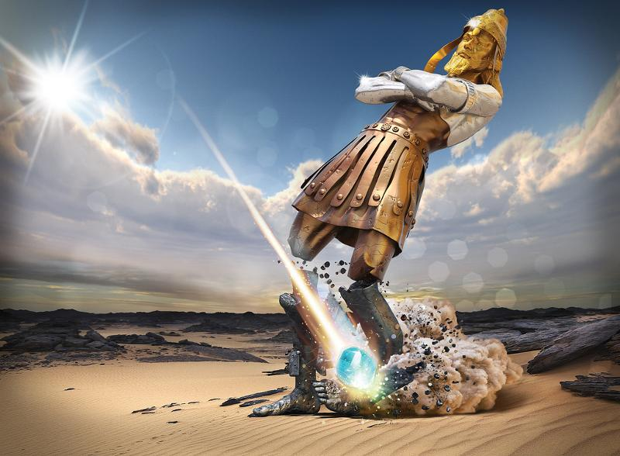
Scripture Predicts
Dan 2:44-45 – “⁴⁴In the days of those kings the God of heaven will set up a kingdom which will never be destroyed, and that kingdom will not be left for another people; it will crush and put an end to all these kingdoms, but it will itself endure forever. ⁴⁵Inasmuch as you saw that a stone was cut out of the mountain without hands and that it crushed the iron, the bronze, the clay, the silver and the gold, the great God has made known to the king what will take place in the future; so the dream is true and its interpretation is trustworthy.”
Notes:
Daniel further prophesied that during the days of the kings of the Roman Empire, God would set up a kingdom that would never be destroyed. Daniel said of this kingdom that was to come that it would not "be left to other people". Scripture elsewhere is quite conclusive that God is the one who sets up kings and kingdoms on earth. Nebuchadnezzar himself affirmed that in his narrative as recorded by Daniel in chapter 4 verses 25 and 32. Later in chapter 5, Nebuchadnezzar's son, Belshazzar, heard the same thing from God through Daniel in an interpretation of the writing on the wall in chapter 5, verse 21. Jeremiah affirmed the same thing in Jeremiah 27:6-7. God gives the kingdoms of the earth to who he chooses, but the kingdom that God will set up will not be overseen or ruled by men. This kingdom will consume all other kingdoms and stand forever. This is of course the kingdom of God.
The "stone" that was "cut out of the mountain without hands" is none other than Jesus Christ, the promised Messiah. Scripture describes Christ as a stone or as rock in numerous places. The imagery being that Christ is enduring, unmovable and strong. Jesus portrayed Himself as the stone which was rejected by the builders and then became the cornerstone, the stone around and upon which all other stones were placed. Paul portrayed Christ as the chief cornerstone of the foundation of the household of God (Eph 2:20). Peter's words as written by inspiration show Christ as the "chief corner stone, elect, precious" (1 Peter 2:6). Peter then went on to say that to those who were disobedient, Jesus became a "stone of stumbling, a rock of offence".
The stone which was cut from the mountain without hands utterly destroyed all the kingdoms represented by the figure in Nebuchadnezzar's dream. It would emerge victorious over all the rest of the glorious kingdoms that would rise after Babylon. This is the answer Nebuchadnezzar received by revelation in response to his thoughts as to what would "come to pass hereafter".

Slide 4
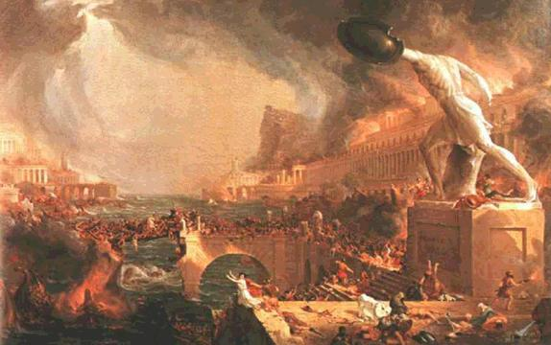
Contributors To The Fall Of Rome
Christianity
Influential church leaders took power away from the emperor
Antagonism vs. pacifism
Christians despised the pagan, Roman system
Notes:
The rise of Christianity in the Roman Empire was one of the primary contributors to its fall.
First, Romans considered their emperor a god. But the Christian monotheism weakened the authority and credibility of the emperor. Church leaders became more admired than the emperor for their moral principles and as they gained more respect from the people, this gave them more power. The emperors primary concern in the empire was to keep peace but peace only came through keeping the citizens happy. This naturally led to the emperor yielding power to the bishops.
Second, as Daniel prophesied, Rome was as strong as iron. Prior to the rise of Christianity, it bullied its way into the lives of every surrounding nation and submitted them to Roman rule. But as Christianity spread through the empire, more of its citizens adopted the pacifist nature of Christianity and people were more interested in winning people to the cause of Christ rather than conquering nations with war. The fear of Rome slowly bled away as the surrounding barbarian nations became bolder in their advances.
Third, as more of Rome became Christianized, its citizens began to despise the roots that Rome was built on seeing as it was founded upon paganism. This led to instability and a lack of trust in certain directions the emperor chose to take Rome.

Slide 5
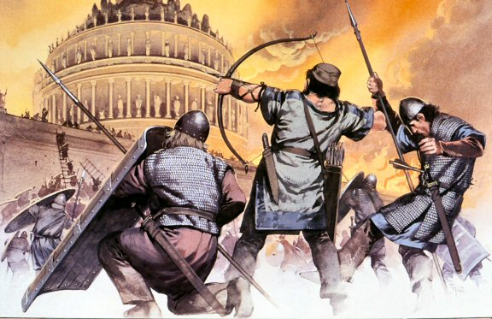
Contributors To The Fall Of Rome
Internal Corruption
Rome became too big to control
Soldiers/Families in distant land adopted local custom
Roman soldiers had to draw back from the Rhine & Danube river to deal w/civil war back home
Notes:
Internal corruption in the Roman Empire was another contributor to its fall.
First, as Rome won new territories through its own invasion, it eventually became too large to manage. Therefore the empire was split into two parts – the western empire with its capital in Rome and the eastern empire with its capital in Constantinople. Constantinople was able to stand up against invasion because it was located on a peninsula and could be easily defended. However, Rome was not so lucky as the push by the barbarian tribes into Rome was to much for the western empire to handle. The Fall of Rome actually only refers to the fall of the western empire as the east would stand for several more centuries.
Second, as Rome won wars in distant lands, the soldiers of these lands as well as their families began adopting the local customs of those nations. This resulted in a divided allegiance that robbed Rome of its strongest citizens and weakened the empire.
Third, as barbarian tribes pressed against the Rhine and Danube rivers, civil wars were also erupting back home that forced the Roman soldiers to retreat in order to focus more on the capital. This allowed the barbarian tribes to press through into the Empire without very little resistance.

Slide 6
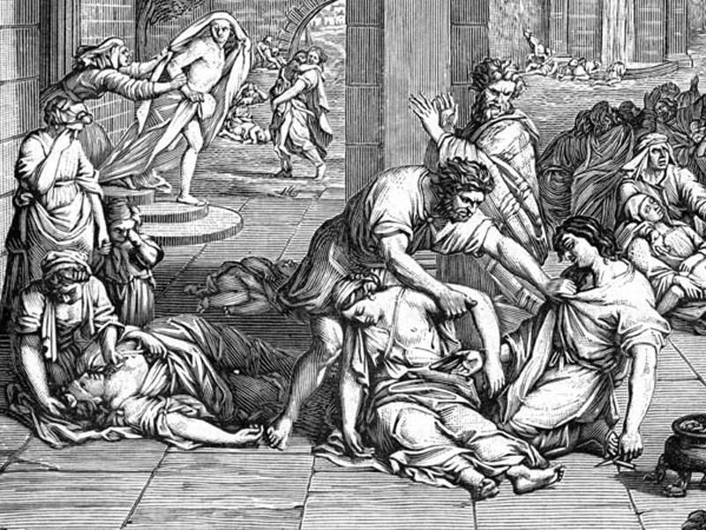
Contributors To The Fall Of Rome
Natural Disasters
Plagues
The Antonine Plague
Newly formed marshes became breeding grounds for mosquitoes carrying disease
Famines
Excessive clearing of forests for agricultural purposes
Earthquakes
366AD, etc.
Notes:
Natural disasters in the Roman Empire was another contributor to its fall.
The Antonine Plague is named after one of its possible victims, Marcus Aurelius Antoninus, the Emperor of Rome. It is otherwise known as the plague of Galen. Galen was a Greek physician who documented the plague. Judging by his description, historians believe that the Antonine Plague was caused by smallpox or measles. We can call this plague a natural disaster because it was caused by a naturally occurring disease and it killed a significant number of people. The Antonine Plague is thought to have come from Roman soldiers returning from battle in the east. Over time, it spread throughout the Roman Empire and some of the tribes to the north. An estimated 5 million people were killed by the Antonine plague. During a second outbreak, a Roman historian named Dio Cassius wrote that 2,000 people were dying each day in Rome. That’s roughly one quarter of those who were infected. This plague significantly depleted Rome’s army.
A malaria epidemic was also responsible for Rome’s dwindling population as a result of unkempt swamps and marshes on the border of the king. These marshes and swamps bred mosquitos that carried malaria and wiped out millions of people.
Famine resulted from the increase in population and the need to sustain them. For agricultural purposes, forests were cleared which caused the topsoil to become loose as a result of the tree roots holding the soil together. Every time it rained, the topsoil would wash away in nearby streams and rivers where it would ultimately be deposited into the harbors leaving them unnavigable by cargo ships. This led to a reduction in trade and food imports and impoverished several areas sending them into famine.
Around 366 CE, the empire was hit with a violent and destructive earthquake. The land around the Mediterranean was left dry and droughty because of the vacancy of the sea. When the tide finally returned, it came back with the weight of a huge flood which poured on the coasts of Sicily, parts of Greece and even on cities in Egypt. 50,000 people lost their lives in the flood in the city of Alexandria alone. The catastrophe boggled and terrified the citizens of Rome which caused a battle of vanity between themselves.

Slide 7
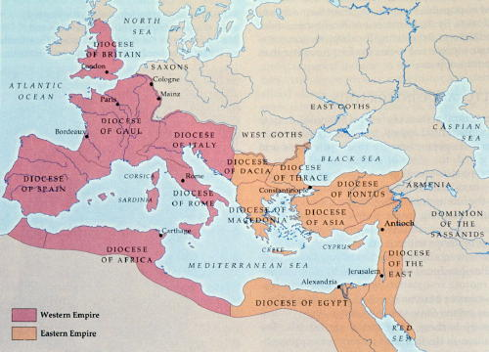
Contributors To The Fall Of Rome
External Invasion
Loss of revenue & territory
410AD: Visigoths (Alaric)
450AD: Vandals (Gaiseric)
476AD: Germans (Odoacer)
Notes:
Finally, external invasion by the Barbarian hordes through Rome into disarray and eventually was the straw that broke the camel’s back that led to is fall.
During the time prior to the Fall of Rome, the diocesan bishops were in power. The Roman Empire had grown increasingly weaker (as prophesied). Though it fortified itself on every front from the enemy, it was not well fortified on its northern frontier. East of the Rhine and north of the Danube rivers were strong German (Teutonic) tribes, and behind the German tribes were the savage Huns, who were constantly crowding the German tribes (Teutonic tribes). The Teutonic tribes feared the Huns more than they feared the Romans.
In A.D. 376 (just 100 years before the fall of Rome), the first barbarian tribe, the Visigoths (West Goths) crossed the lower Danube to expand their borders. Then the Ostrogoths (East Goths) crossed the Roman borders. The Goths were pushing the Romans, and the Romans fought them at the Battle of Adrianople, where the Roman army was destroyed. Later, the eastern emperor of the Empire, Theodosius, raised a large army and pushed the Goths back from the eastern section of the Empire. Thereafter, the barbarians left the eastern part of the empire alone and the Goths turned and went west towards Rome.
As Rome reached its limit in land acquisition, it also could not increase it revenue. Revenue was needed to increase and support the army. Once the army could not be supported, it made it easier for the barbarians to invade. As territory was lost to the Barbarians, so was additional revenue. This circular issue set the stage for 3 separate invasions and sacking of Rome.
In 410 AD, the Visigoths (West Goths), led by Alaric, breached the walls of Rome and sacked the capital of the Roman Empire. The Visigoths looted, burned, and pillaged their way through the city, leaving a wake of destruction wherever they went. The plundering continued for three days. For the first time in nearly a millennium, the city of Rome was in the hands of someone other than the Romans. Once Alaric took what he wanted, he left Rome and headed to North Africa though he died before he got there. This was the first time that the city of Rome was sacked, but by no means the last. When Alaric died, his successors more or less peacefully coexisted with the Romans. The Ostrogoths settled in Italy after the fall of Rome in A.D. 476. The Visigoths settled in southern Gaul (France) and northern Spain.
In 454, Emperor Valentinian murdered Aetius. The following year Valentinian was stabbed to death by Aetius’s follower. The story goes that Eudoxia, the widow of the emperor, was then forced to marry Maximus against her will. Petronius Maximus was generally believed to have been the grandson of the usurper Maximus who had been crushed by the Theodosius the Great. He had been Consul at age 38 and became Praetorian Prefect of Italy six years later. He became emperor of the West Empire after Valentinian’s death. The widow Eudoxia knew that an appeal to Constantinople would have little chance of being answered. So she decided to write to Gaiseric, inviting him to take possession of Rome. However no invitation was needed, Gaiseric’s peace treaty had been with Aetius and Valentinian. Now they were dead and so was the treaty. Emperor Maximus who hurried to get his son married to Eudoxia instead of Huneric, to whom she was long since promised, angered Gaiseric. The Vandal fleet had been built up for the last ten years and now awaited a major expedition. A major Vandal fleet left Carthage for Rome. Gaiseric and his nobles expected to clash with the imperial fleet somewhere at sea. Though when they sailed along the coast of Italy they found themselves unopposed and sighted the port of Rome, Ostia, on 31 May 455. The Romans were already terrified, sending their wives and daughters away to safety. The gates of Rome couldn't cope with the number of people seeking to flee. Emperor Maximus had no chance to raise his army in defense of his capital and decided to ride out of Rome. Unfortunately for him, an angry Roman crowd recognized him and stoned him to death. This emperor had reigned for just 70 days. Three days after Maximus' death, unopposed, King Gaiseric stepped ashore at Ostia. For the fourth time in less than half a century, a barbarian stood at the gates of Rome. Fearing for the safety of Rome, Leo I decided to speak with the leader of the barbarians on the behalf of his city. He was met by King Gaiseric and persuaded him not to burn and slaughter. Gaiseric decided to give certain promises: there would be no killing, no torturing to discover the location of hidden treasure and no destruction of buildings, public or private. On these terms the gates of Rome were wide open to him allowing him to enter the city with no resistance. The Vandals plundered for two weeks. While Gaiseric stayed at the Imperial palace, his men took all the treasures, statues, Solomon’s Temple (menorab), even part of the gilded roof of the Temple of Jupiter Capitolinus was removed. Yet his greatest prize were Empress Eudoxia, her two daughters, Eudocia and Placidia, and Gaudentius, the son of Aetius. Everything was carted to Ostia, loaded into the waiting ships, from where he and his men departed in good order and sailed back to their stronghold in North Africa. The people of Rome and its buildings were left unharmed (if indeed this story was true). The Vandals would eventually settle in southern Spain and North Africa.
The Huns were savage and fierce fighters, the most powerful of all the barbarians. Under the leadership of Attila, they pushed towards Gaul. Because both the other barbarian tribes and the Romans feared the Huns, they united in battle to fight the Huns at Chalons in A.D. 451. Attila and his armies were turned back and the power of the Huns was broken.
Odoacer (or Odovacar) was a Germanic warrior who worked his way up through the ranks of the Roman army. When the western emperor Julius Nepos was overthrown by the Roman general Orestes, Odoacer defeated Orestes, deposed and exiled Orestes' son Romulus Augustus, and refused to acknowledge any new western emperor, officially putting an end to the Western Roman Empire in 476. He styled himself King of Italy and conquered parts of present-day Croatia and Austria.

Slide 8
Action
Reaction
The leadership vacuum in Rome became a stepping stone to the papacy.
Notes:
When the Barbarian invasion took down Rome, it created a leadership vacuum in Rome. Though Odoacer took the title of king of Italy, Rome was left without an Emperor. The work of missionary monks over the previous couple hundred years had “converted” many Barbarians to Christianity though the majority of them were Arians (believed Jesus was a created being). Since most Barbarians were “nominal” Christians, more authority was given by them to the bishop of Rome. This became a major stepping stone to the papacy.

Slide 9
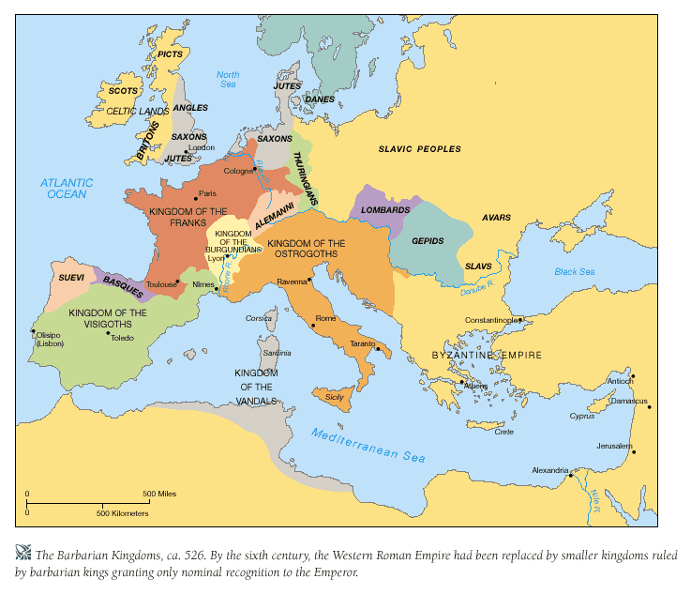
Notes:
By the end of the 5th century, the western section of the Roman Empire was completely under barbarian dominion and broken up into various states. The eastern section of the empire, called “Byzantine”, remained mostly unharmed for several more centuries because of their strategic location and defenses. In fact, Byzantine was strengthened because many prominent members of Roman society in the west had fled east when they knew the Barbarians were coming.
When Rome fell, there was no emperor left, but the bishop of Rome stayed and was respected by the barbarian tribes because they were at least nominal professing Christians. This left the bishop preeminent in the social life of the city, and his moral authority increased enormously as a result. In the east, the emperor would often have dispute with the bishop of Constantinople, and he would appeal to the bishop of Rome as an arbitrator. The bishop of Rome took the place of the emperor and became a political leader as well as a spiritual leader. His authority went almost unchallenged. This set the final stage for the papal system.
This was a tumultuous time. Catholics, Barbarians (Arian Christians), and pagans all tried to settle down side by side, and this did not make for harmonious relationships. This is the beginning of what is called “The Dark Ages” in history, the initial 500 years after the fall of Rome in which historical records of many European states are scarce.

Slide 10
Action
Reaction
Many Barbarians “converted” to Christianity merely out of loyalty to their king
Notes:
Many of the Barbarians were converted merely out of loyalty to their king/leader. Stories are numerous of kings being baptized and almost immediately the soldiers and citizens would follow suit. Just as the unconverted pagans in Rome brought their idolatrous superstitions into the church, the barbarians likewise never separated from their pagan ways and were likewise responsible for the hybridizing of Christian/pagan doctrines together to what eventually became known as Catholic doctrine. There has been and also will be great danger in unconverted people infiltrating the church and taking it away from what God intended Christ’s body to be.

Slide 11
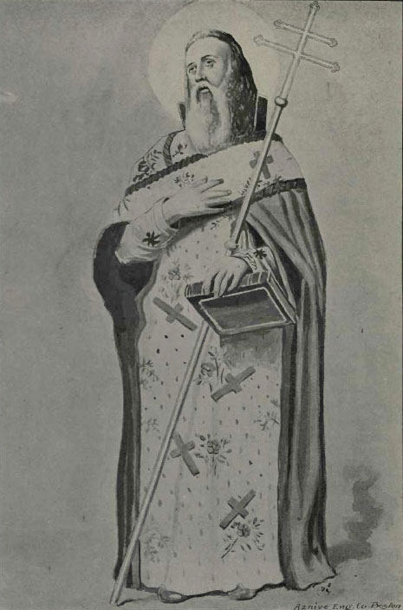
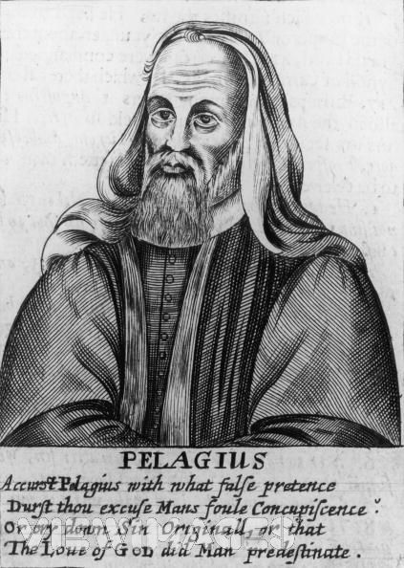
Barbarians Evangelized
Armenians (Gregory the Illuminator)
Armenian King Tiridates was baptized in 301AD
Bible translated to Armenian in 433AD
British Isles (???)
Three Celtic bishops came to Council of Arles in 314AD
Notes:
Most of the barbarians were uneducated and could not read or write though they were not stupid. They had little or no respect for culture or learning and destroyed much of the Roman Christian culture of that day. But fortunately for the church in the Roman Empire, many of the barbarian tribes were professing Christians as result of the work of missionaries. They were Arians and not orthodox, but they were at least somewhat sympathetic. Thus, many true Christians were spared death and church property was not destroyed.
Armenia was converted by Gregory the Illuminator when in 301AD King Tiridates was baptized. In 433 the bible was translated into the Armenian language. Its been said that several million were baptized under the influence of Gregory the Illuminator.
The British Isles were also won over to Christianity but it is difficult to know exactly when it first happened. We know for certain that three Celtic bishops from Celtic Britain were in attendance at the Council of Arles in 314AD. This is also where Pelagius was from – he opposed the idea of predestination and upheld that humans had free will. Augustine was therefore a fierce opponent and Pelagius was branded a heretic at the Council of Carthage. The Celtic British Christians were left defenseless when Roman soldiers withdrew the area to meet the threat of Barbarian invasion and the Celtic people were then exterminated and driven into the western and northern hills by the pagan Anglo-Saxons.

Slide 12
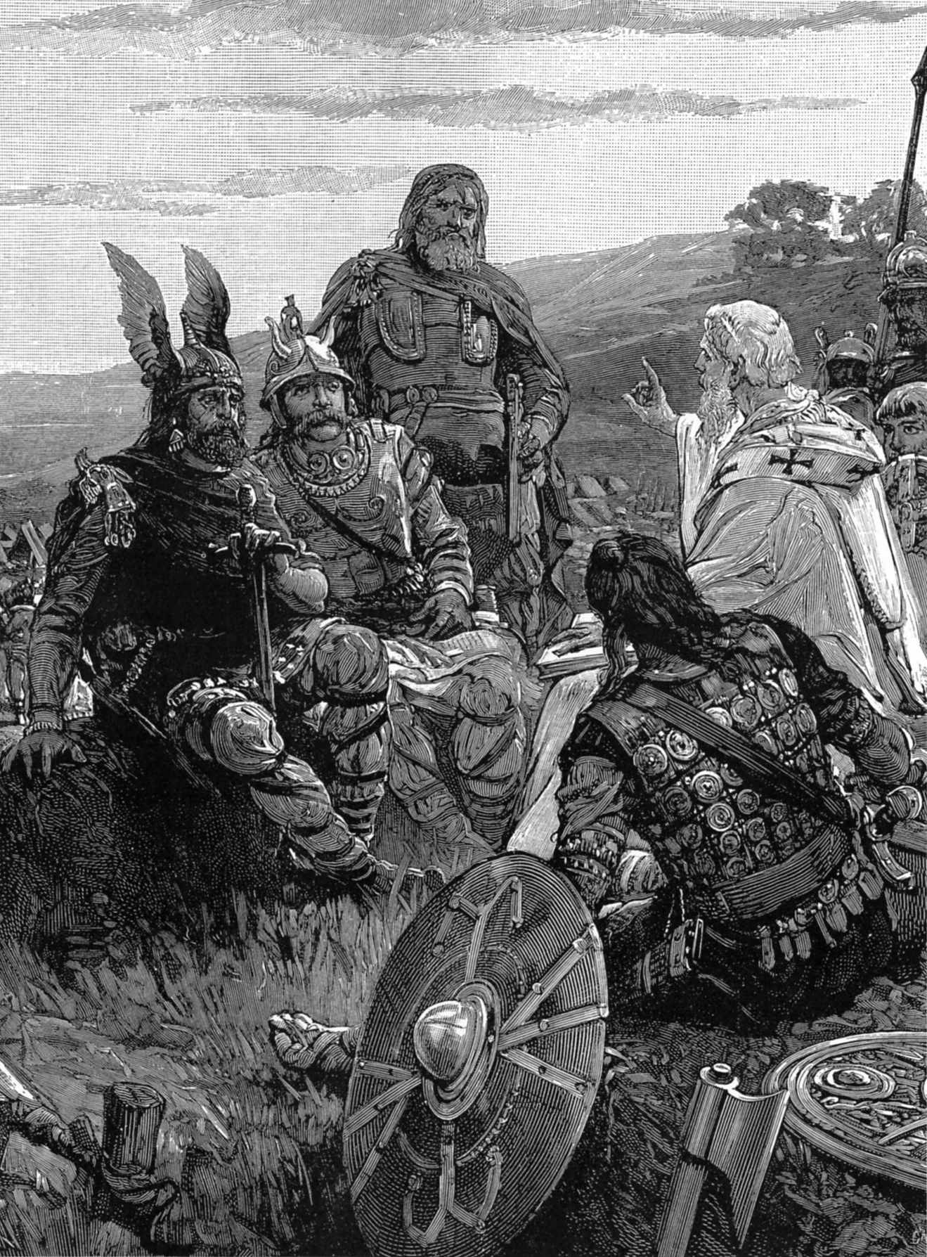
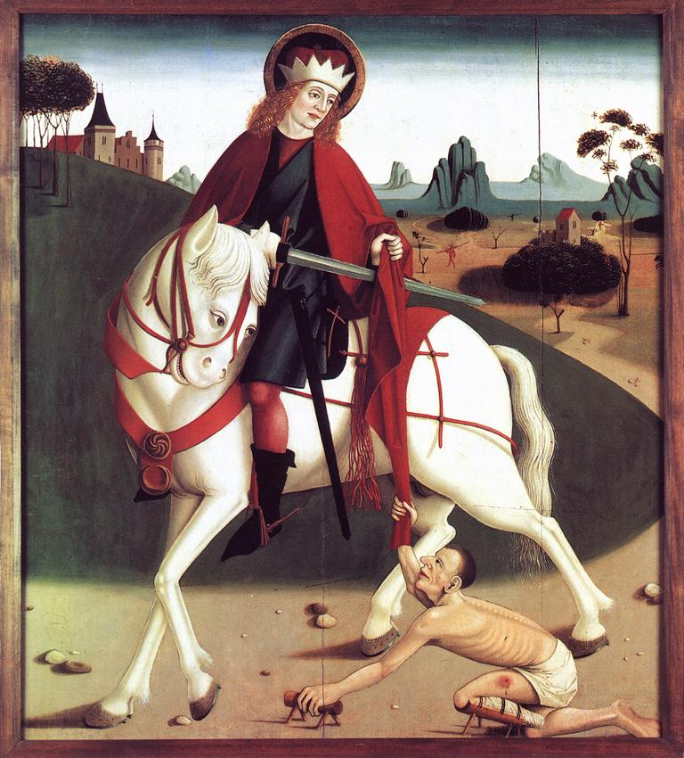
Barbarians Evangelized
Goths (Ulfilas)
Taught Arianism from 311 – 381AD
Translated scripture to Gothic language (except 1 & 2 Kings)
Burgundians (Martin of Tours)
Preached to Burgundians in southern Gaul from 355-400AD
Organized soldier monks into bands to destroy groves where pagan gods were worshipped
Notes:
Before the Visigoths poured over the Danube River, missionary work had already begun amongst the Gothic communities. Ulfilas, though an Arian Christian, was known for teaching the Goths and many who invaded Rome came over as Christians. He also helped educate the Goths by creating them an alphabet and giving them scriptures in their own tongue. Because they were so warlike, though, Ulfilas would not translate 1 & 2 Kings because he felt like it would be a stumbling block to them. The fact they were converted to Arianism caused not just a little dissension between them an orthodox Christians once they settled in Rome.
The Burgundians were a pagan Teutonic tribe settled in southern Gaul. Martin of Tours was one of the first to evangelize this area. In addition to preaching, he used rough tactics in his mission work by organizing bands of soldier monks to destroy the groves where they worshipped their pagan gods. One of the most famous stories told about Martin of Tours is how he found a scantily clad man in the dead of winter and promptly cut his own cloak in half and gave one to him.

Slide 13
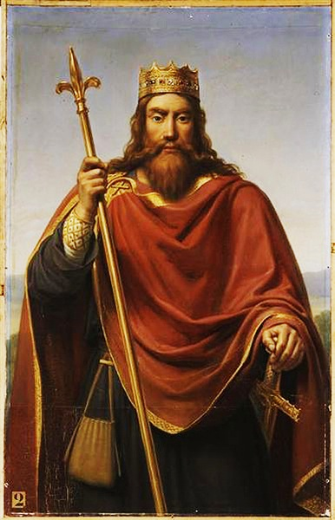
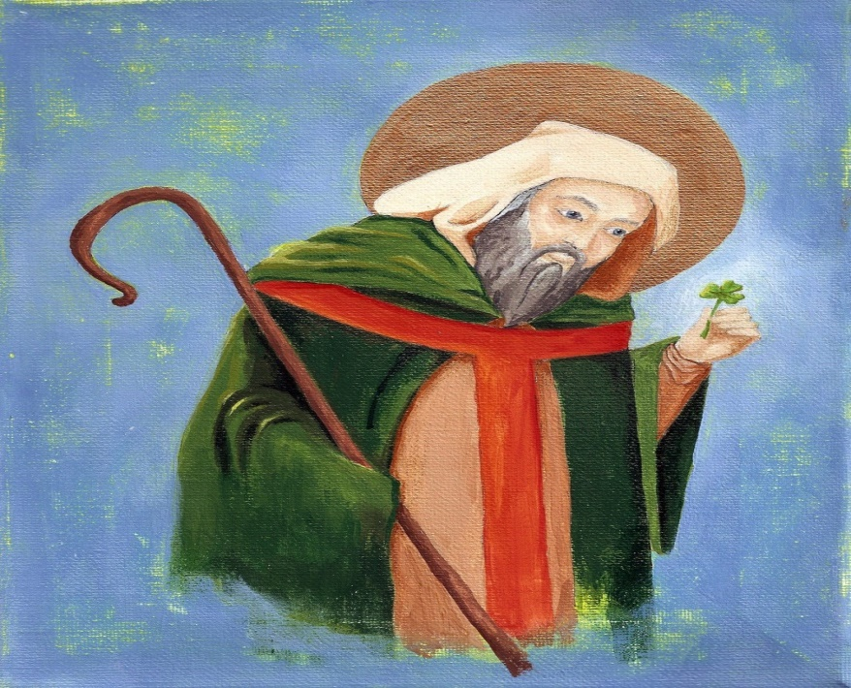
Barbarians Evangelized
Franks (Clovis)
Clovis, King of Franks, marries Clotilda, princess of Burgundy
Through Clotilda’s influence, Clovis became a Christian in 496AD
Clovis’ conversion caused the majority of the Franks to follow suit
Ireland (Patrick)
Preached to Celts of Ireland from 432 – 461AD
Felt pressure from druid religion
Organized Christians around monasteries
Notes:
One of the conversions that would have the farthest reaching affects on the church was that of Clovis, King of the Franks. Clovis became a Christian through the influence of his queen, Clotilda. As a result of his conversion, all of the Franks followed suit out of respect for their king. The Frankish monarchy would become the most ardent supporter of the papacy during the early dark ages and Frankish kings also crossed the alps many times to save the Roman bishop from his enemies in Italy. France was also the first to stop the Muslim invasion into Europe and to keep is influence from spreading there.
Ireland was evangelized by a man named Patrick, who our holiday is named for. Much of his life is a mystery and there are many legends about him that can’t be verified. We do know that he worked amongst the Celts of Ireland from 432 – 461AD despite the efforts of the Druid religion to put a stop to it. He organized Christians around monasteries in the tribal areas. He was famous for teaching the concept of the trinity to the pagans through the illustration of the 3-leaf clover and was successful for converting many of them.

Slide 14
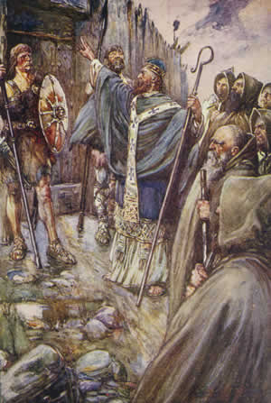
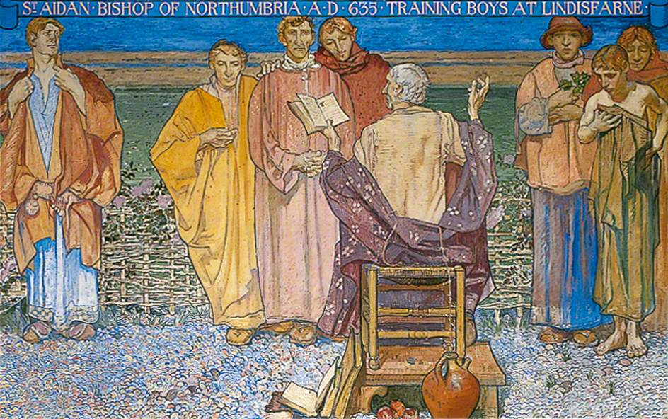
Barbarians Evangelized
Scotland (Columba)
Sailed from Ireland and founded monastery in Scotland in 563AD
Monastery became the center for evangelism for all of Scotland
Anglo-Saxons (Aidan)
Though the British Isles had been evangelized, Christianity was dying to due to Anglo-Saxon invasion that brought paganism
Aidan preached from village to village, politely conversion with both rich and poor about the truths of Christianity
Notes:
From Ireland, a man named Columba sailed to Scotland to mimic what Patrick had done in Ireland. He founded a monastery that became the center of evangelism for all of Scotland.
From Scotland, a man named Aidan set out to convert the Anglo-Saxons of the northern British Isles who had nearly wipes out Christianity. Aidan was a people person who preached from village to village, politely conversing with the villagers about the truths of Christianity.

Slide 15
Questions For Discussion Next Week
What should be our response to the inevitable demise of our nation?
How do we ensure people are converted to Christ and not to “us”?
What are some ways to help Christian leaders stay humble?
Notes:
Here are our questions for next week:
What should be our response to the inevitable demise of our nation?
How do we ensure people are converted to Christ and not to “us”?
What are some ways to help Christian leaders stay humble?

Slide 17
Notes:
As we study church history, we want to be careful to make sure we learn the practical applications to help us in our walk with God today. History contains more than just stories, but also action/reactions that are similar to the issues we encounter in the 21st century. Learning where early Christians succeeded and failed will help us solidify our faith.

Slide 18
Practical Applications
1) What should be our response to the inevitable demise of our nation?

Slide 19
Practical Applications
1) What should be our response to the inevitable demise of our nation?
Pray for our nation
Jer 29:7 – “But seek the welfare of the city where I have sent you into exile, and pray to the Lord on its behalf, for in its welfare you will find your welfare.”
1 Tim 2:1-4 – “¹First of all, then, I urge that entreaties and prayers, petitions and thanksgivings, be made on behalf of all men, ²for kings and all who are in authority, so that we may lead a tranquil and quiet life in all godliness and dignity. ³This is good and acceptable in the sight of God our Savior, ⁴who desires all men to be saved and to come to the knowledge of the truth
Remember God is in control
Prov 21:1 – “The king's heart is a stream of water in the hand of the Lord; he turns it wherever he will.”
Dan 2:21a – “It is He who changes the times and the epochs; He removes kings and establishes kings”
Submit to our new governing authorities
Rom 13:1 – “Every person is to be in subjection to the governing authorities. For there is no authority except from God, and those which exist are established by God.”
Dan 6:21 – “Then Daniel spoke to the king, ‘O king, live forever!’”

Slide 20
Practical Applications
2) How do we ensure people are converted to Christ and not to “us”?

Slide 21
Practical Applications
2) How do we ensure people are converted to Christ and not to “us”?
Always give God the glory
Matt 5:16 – “Let your light shine before men in such a way that they may see your good works, and glorify your Father who is in heaven.”
Don’t allow people to excessively complement you
Acts 14:11 – “When the crowds saw what Paul had done, they raised their voice, saying in the Lycaonian language, ‘The gods have become like men and have come down to us.’”
Acts 14:14 – “But when the apostles Barnabas and Paul heard of it, they tore their robes and rushed out into the crowd”
Don’t baptize people too quickly
1 Cor 1:14-15 – “I thank God that I baptized none of you except Crispus and Gaius, so that no one would say you were baptized in my name.”

Slide 22
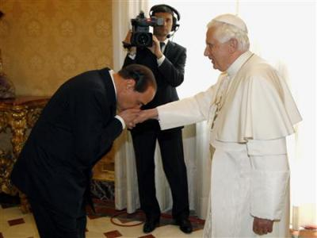
Practical Applications
What are some ways to help Christian leaders stay humble?

Slide 23
Practical Applications
What are some ways to prevent Christian leaders from becoming prideful?
Don’t allow them authority outside God’s word
1 Pet 5:2 – “Shepherd the flock of God among you, exercising oversight not under compulsion, but voluntarily, according to the will of God; and not for sordid gain, but with eagerness”
Show yourself a servant
1 Pet 5:5 – “You younger men, likewise, be subject to your elders; and all of you, clothe yourselves with humility toward one another, for God is opposed to the proud, but gives grace to the humble.”
John 13:5 – “Then He poured water into the basin, and began to wash the disciples’ feet and to wipe them with the towel with which He was girded.”

